Slide 1
DEMO :
3 Researcher Personas

Slide 2
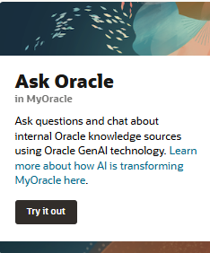

Use Case 1 : Exploratory Data Analysis and Predictive ML Model Development
Goals
Load dataset into data warehouse
Gain insights from the data
Train machine learning model to perform prediction
Evaluation model performance
USER 1
Role : Researcher
Current Activity: Currently working on writing a research paper on his/her research.
Challenges
Platform availability to perform and manage experiments
Complex environment setup
Difficult to connect data sources with the experiment platform
Objective
Able to perform exploratory data analysis and developing Predictive machine learning model necessary to prove some hypotheses of his/her research.
Solutions
High-availability data science platform
No environment setup needed to start working on a data science project
Seamless integration between data warehouse and development platform

Slide 3
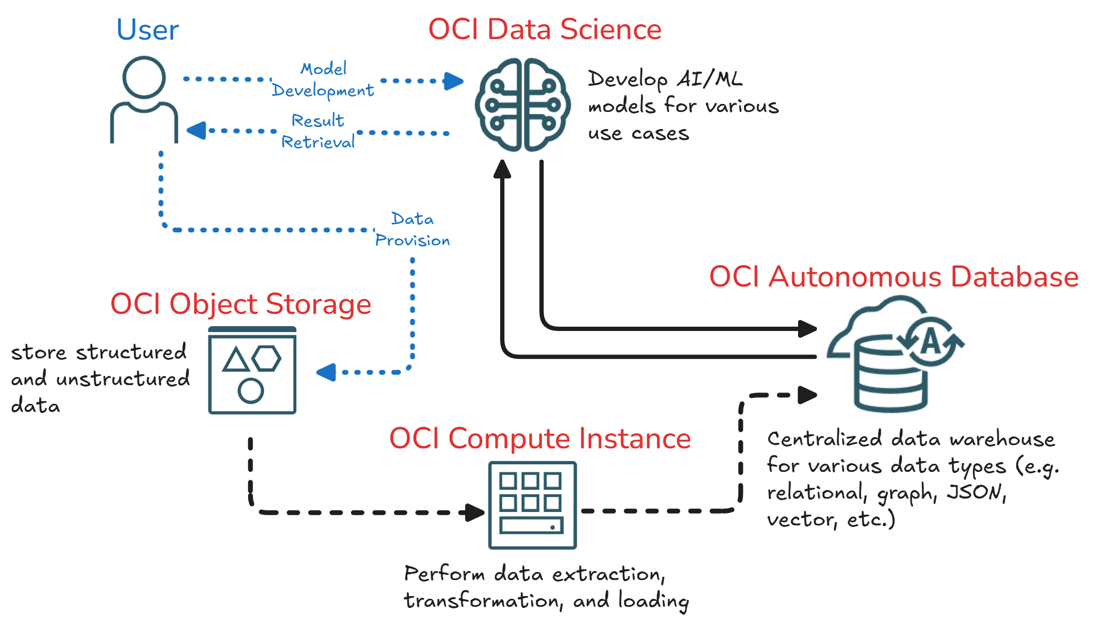
Use Case 1 : Exploratory Data Analysis and Predictive ML Model Development

Slide 4
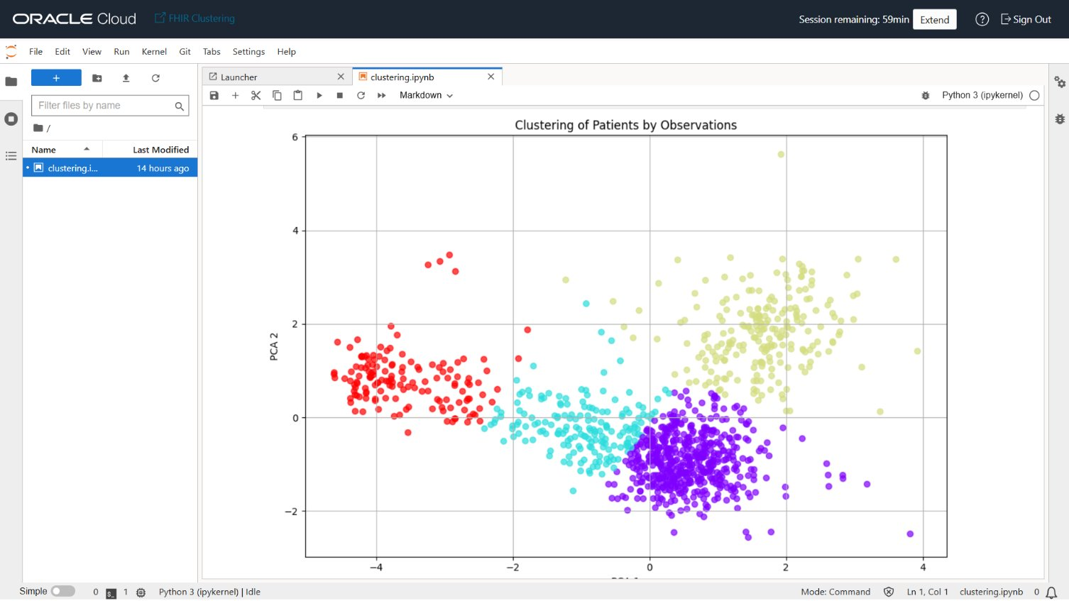
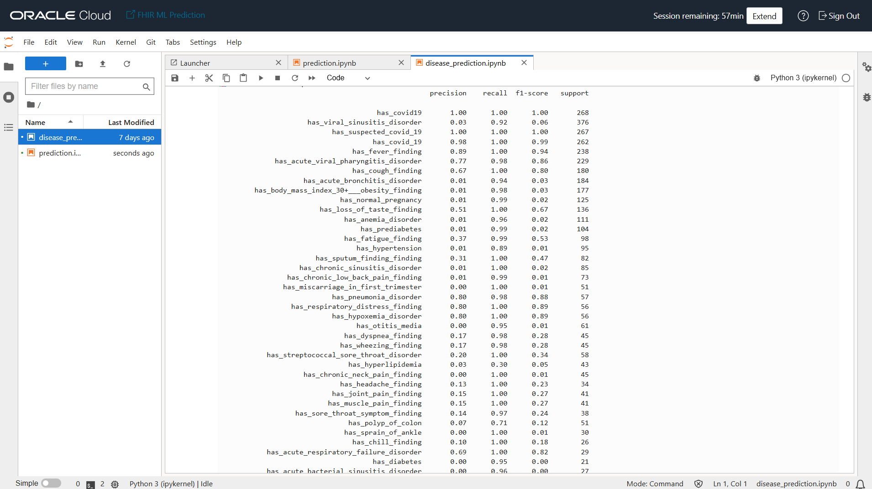
Use Case 1 : Exploratory Data Analysis and Predictive ML Model Development

Slide 5
Use Case 2 : AI-Powered Medical Assistance
Goals
Input symptoms to receive potential condition suggestions
Explore medical topics to enhance understanding of diseases and treatments
USER 2
Role : Public, Medical Student
Current Activity: Checking symptoms, explore potential early diagnoses, and deepen their understanding of various medical conditions for study or personal health awareness.
Challenges
High technical barrier for non-CS users
Complex system setup process
Limited portability across devices and platforms
Objective
Able to utilize a smart digital assistant to interpret health-related information, identify potential medical conditions, and deepen understanding of clinical concepts for educational or self-care purposes.
Solutions
Simple onboarding to test the system (just simply give it a question)
Minimum setup design
Access from all devices and platforms (cloud-based)

Slide 6
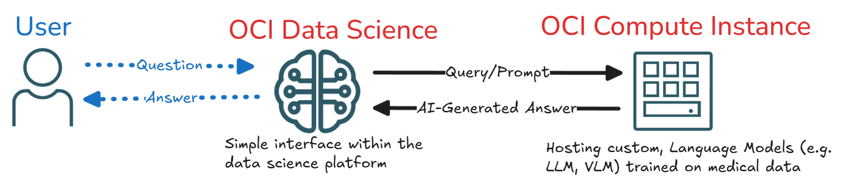
Use Case 2 : AI-Powered Medical Assistance

Slide 7
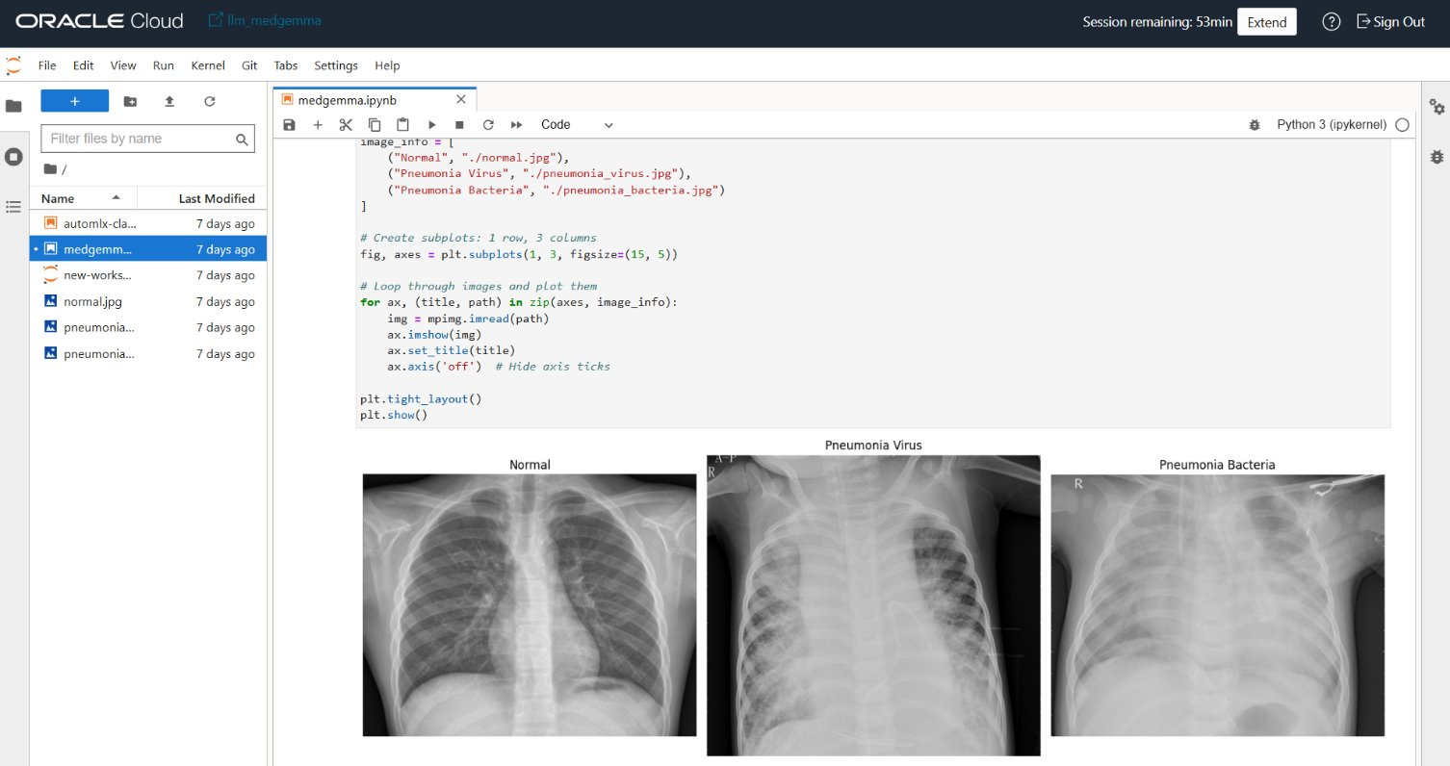

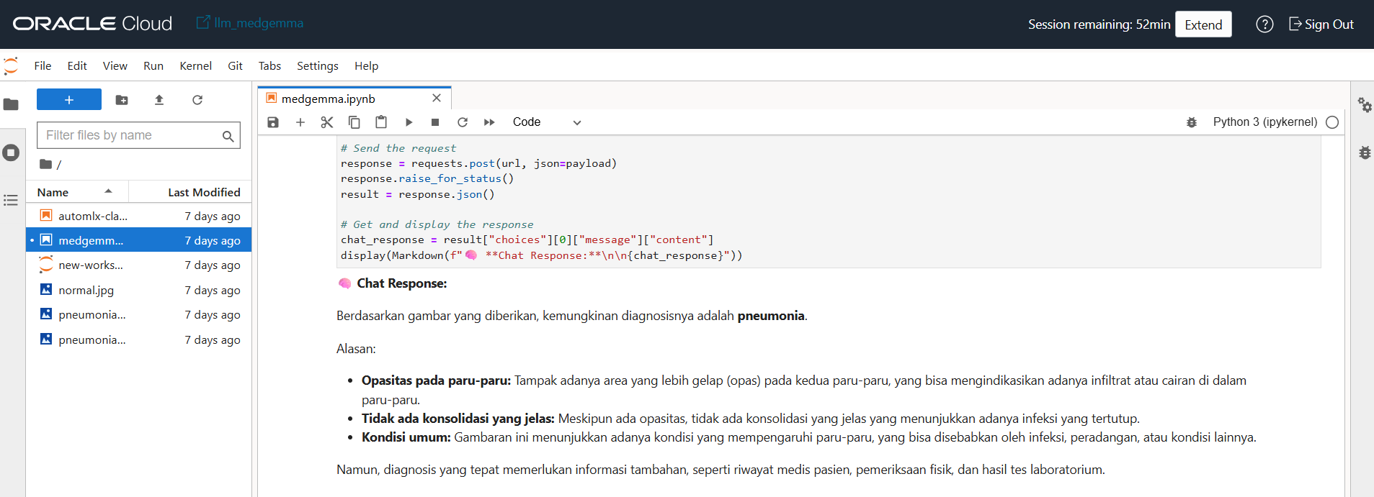
Use Case 2 : AI-Powered Medical Assistance

Slide 8
Use Case 3 : AI-Powered Trusted Medical Knowledge Retrieval
Goals
Get cited, reliable answers
Find relevant studies or documents
Speed up medical information search
USER 3
Role : Researcher, Doctor, Physician
Current Activity: Searching for up-to-date, accurate medical knowledge from verified databases or confidential institutional sources to support clinical decisions, research, or case studies.
Challenges
Time-consuming manual search
Complex environment setup for non-technical user
Integration between development environment and data warehouse
Objective
Provide a smart assistant that helps medical professionals find verified, relevant, and context-aware medical knowledge from authoritative sources to enhance research, diagnosis, and treatment planning.
Solutions
Providing high-availability data science platform for various use cases
No pre-liminary setup needed to start working on the platform
Seamless integration between data source and development platform

Slide 9
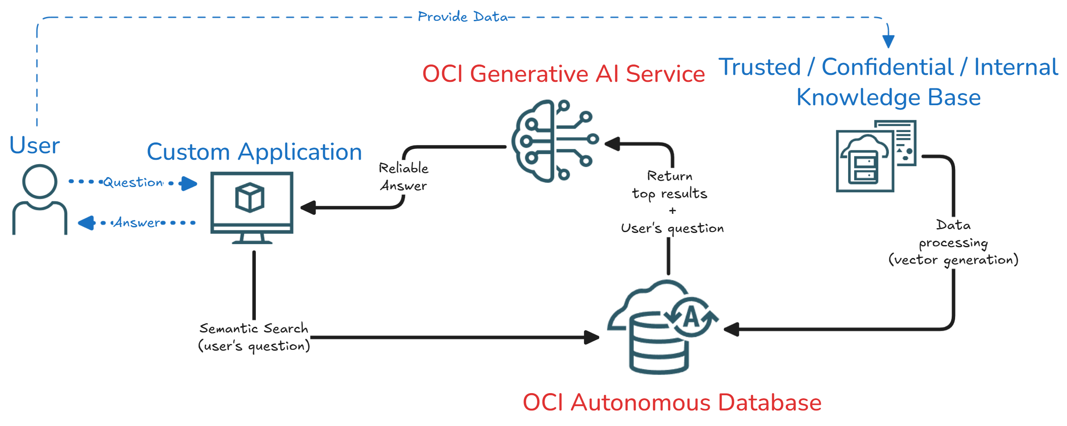
Use Case 3 : AI-Powered Trusted Medical Knowledge Retrieval

Slide 10
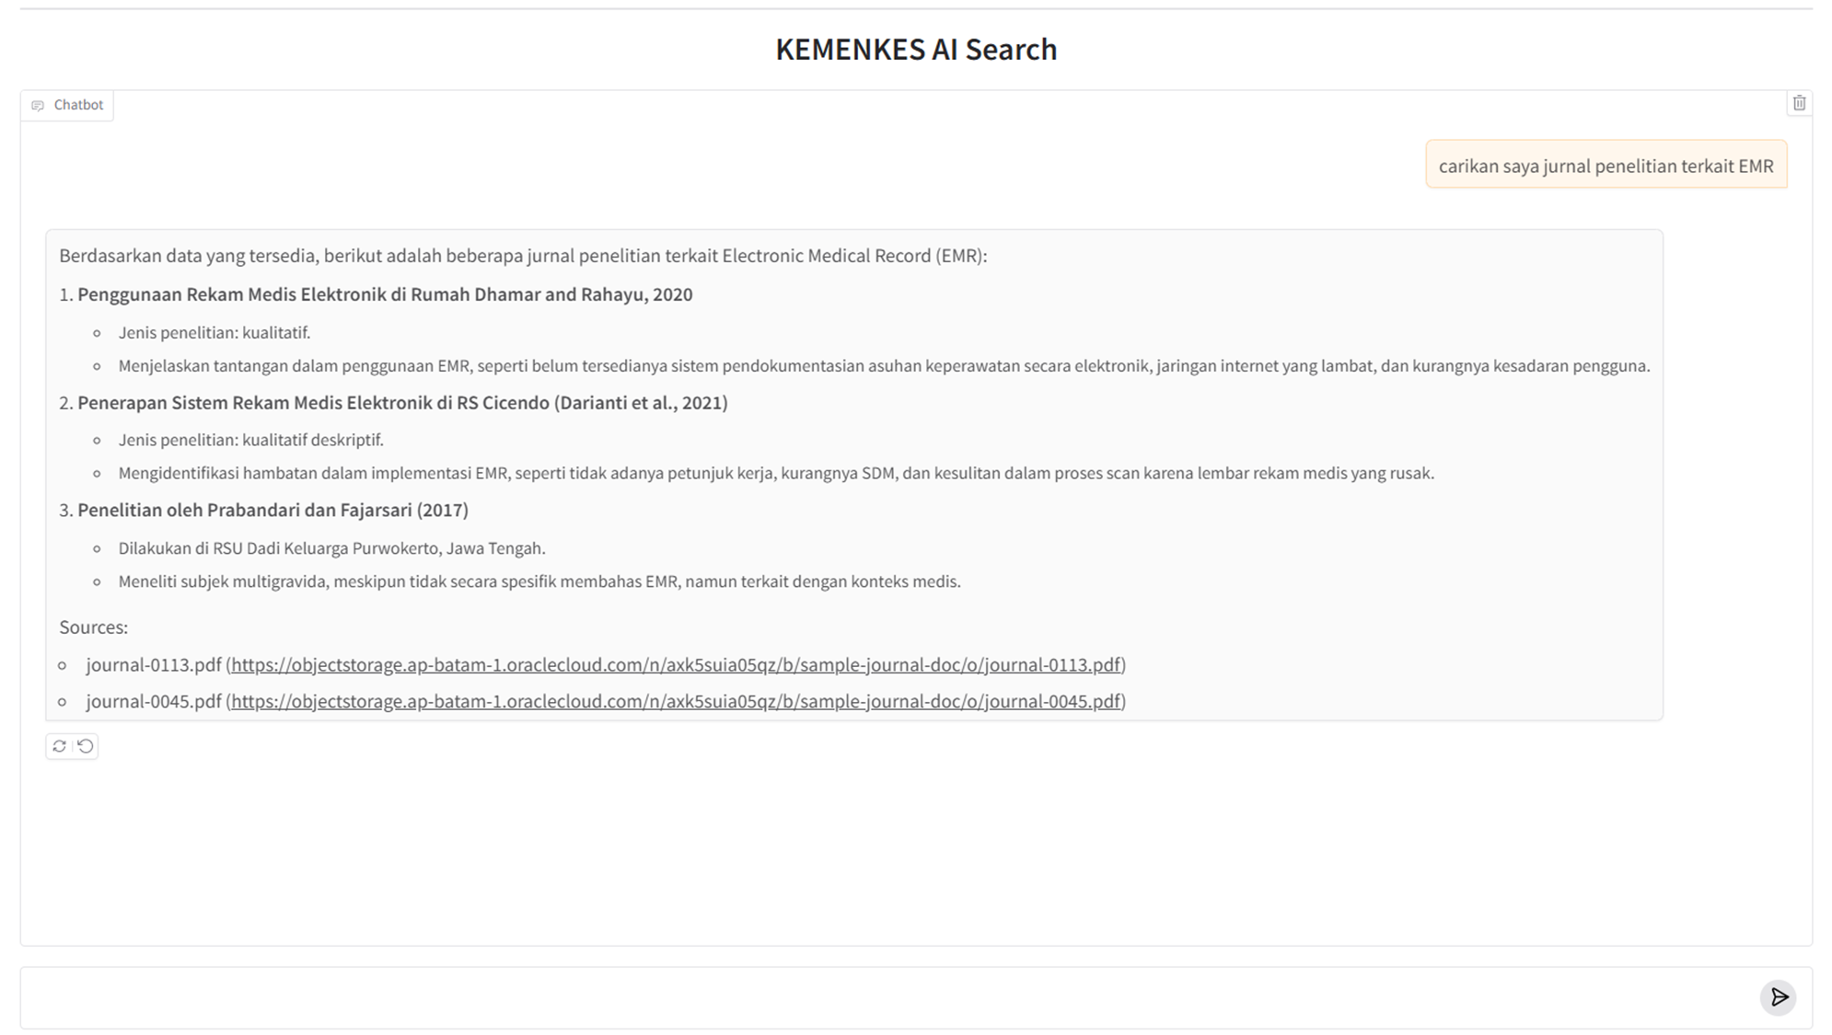
Use Case 3 : AI-Powered Trusted Medical Knowledge Retrieval

Slide 11

Better care.
Better outcomes.
Better together.

Slide 12


